Slide 1
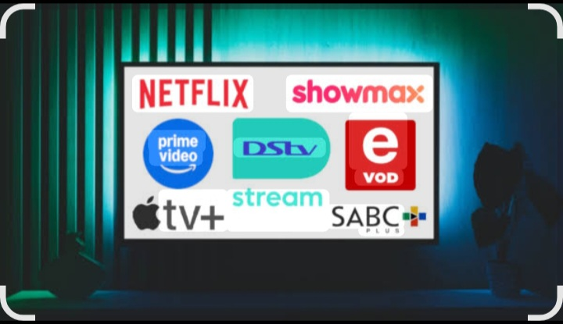
Bright TV

Slide 2
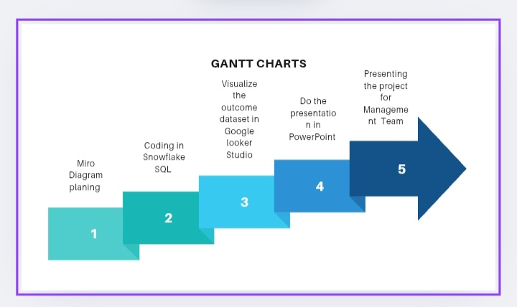

Slide 3
Table of Content
Gantt Charts…….………………………………………...3
Miro Diagram……………………………………………..4
SQL……………………………………………………………..5
Google Looker Dashboard..…………………….….6
Recommendations……………………………………11

Slide 4
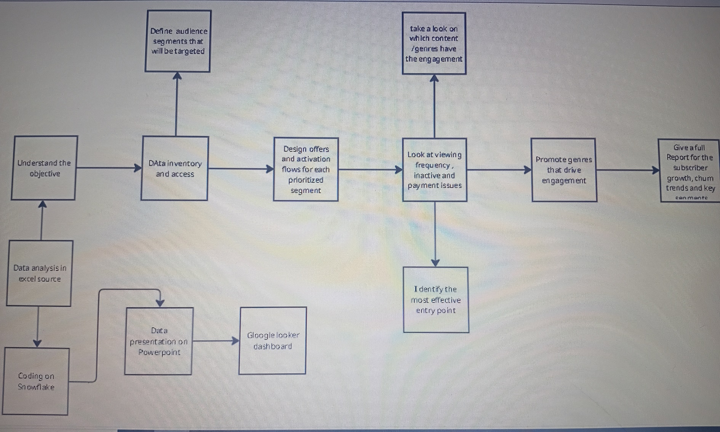
Miro Planning

Slide 5
The above workflow ensures we leverage data to segment our audience, design effective offers, optimize engagement through content, and report on growth and churn trends to guide business decision.
Data foundation we begin by understanding the business objective, coding in snowflake, analyzing data on Excel. Insights are visualized via Powerpoint and Google looker Dashboard.
Content focus we review which genres or content generate the most engagement and promote those genres strategically.

Slide 6
SQL Explanation
Our code transforms raw viewing logs into actionable insights about customers.
Who they are (Demographics and Age buckets)
How they behave( frequently, day/month patterns, sessions length)
This helps leadership track subscriber engagement , churn risk and growth opportunities in a clear and structured way.

Slide 7
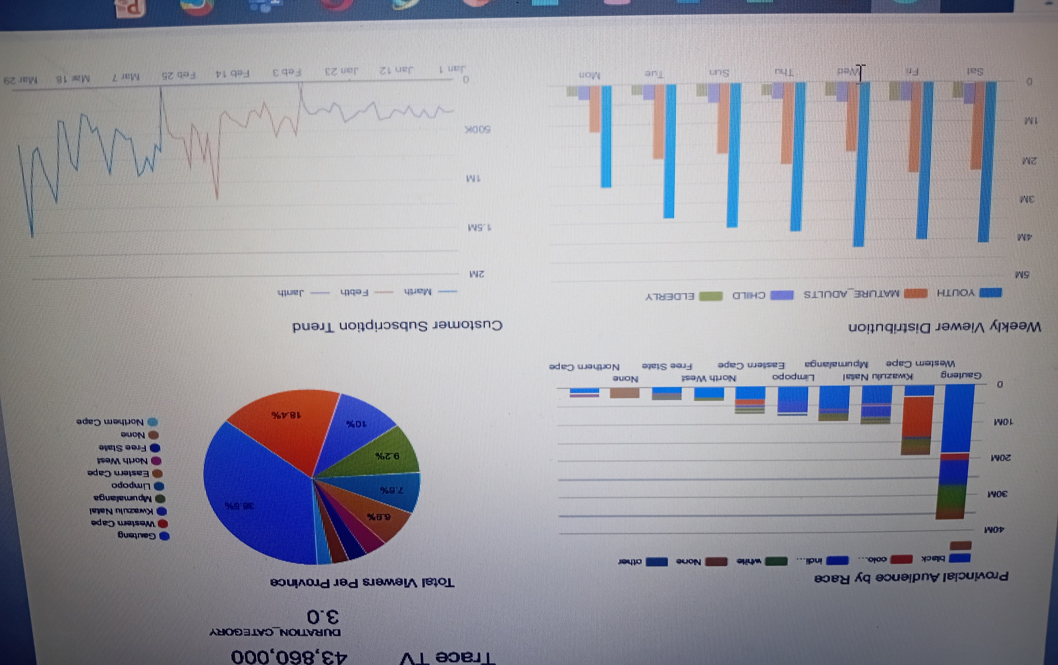
Google Looker Dashboard

Slide 8
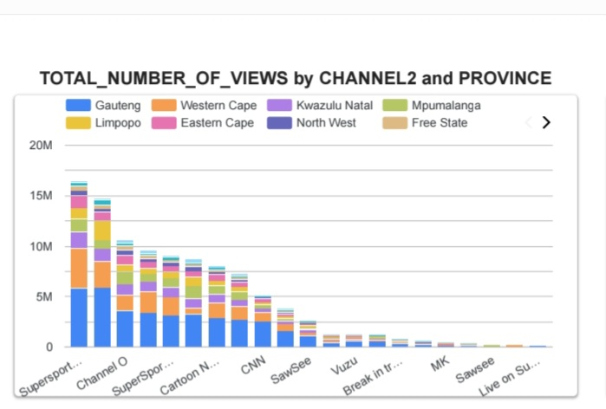
This chart shows the shows the total number of TV channel views across provinces in South Africa.
Super sport has the highest overall viewership followed by Channel O and Cartoon Network. These channels attract more viewers.
Gauteng consistently contribute the largest share of viewership across all channels.
Other contributing provinces include Western Cape , KwaZulu-Natal.

Slide 9
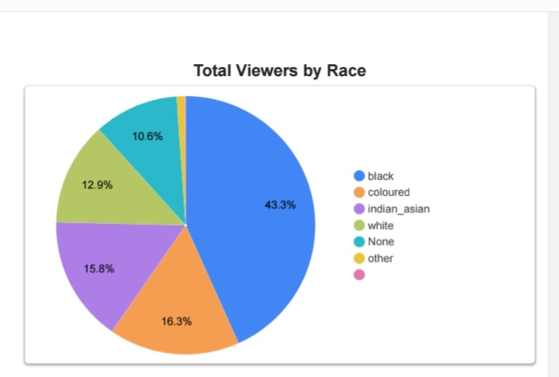
The pie charts illustrate the distribution of total viewers by race.
Black viewers form largest share, nearly half of the total audience.
Coloured and Indian viewers represent the next largest groups.
White viewers reflect a moderate portion of the audience.
Others contribute very little in viewing the channels.

Slide 10
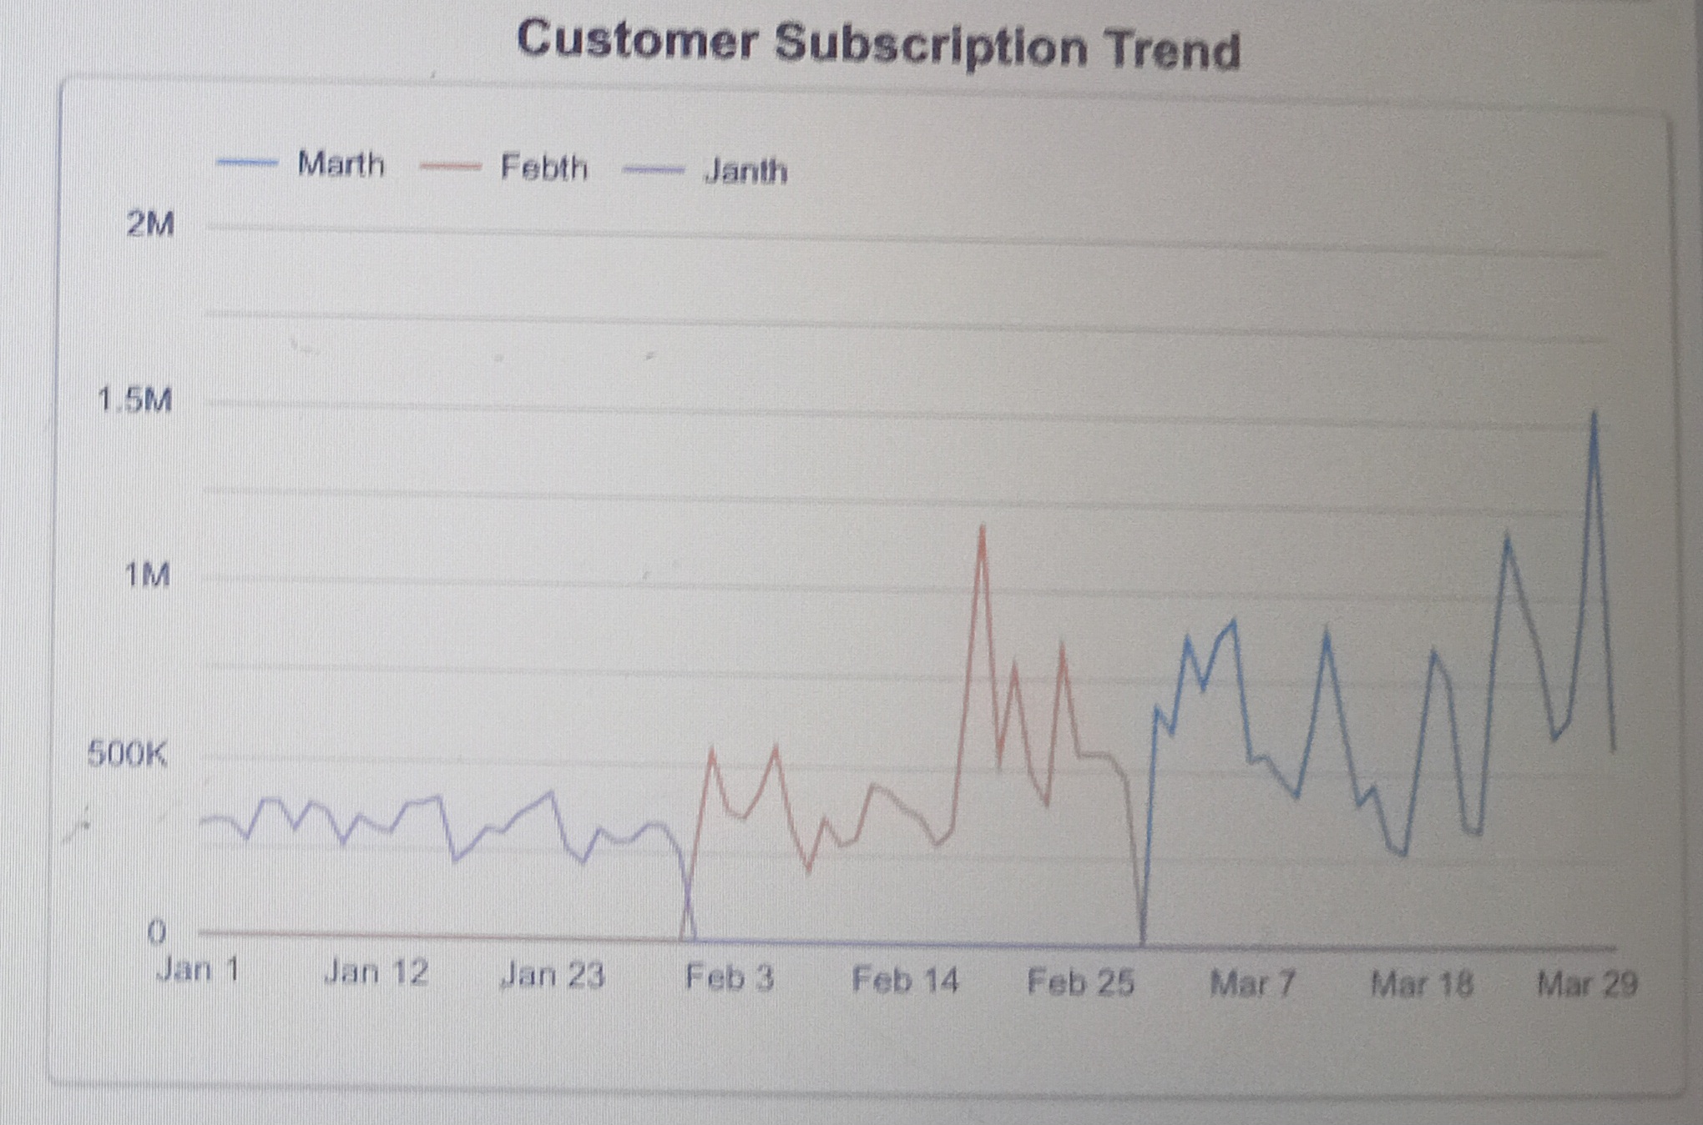
Customer Subscription Trend
The line charts above shows how customer subscription numbers changed over three months.
In january the subscription remained fairly stable.
In february it shows much higher fluctuations. There are several high spikes with highest point reaching 1.3m.
In march shows a strong upward trend, subscription continues increasing reaching above 1m towards the end of the month.

Slide 11
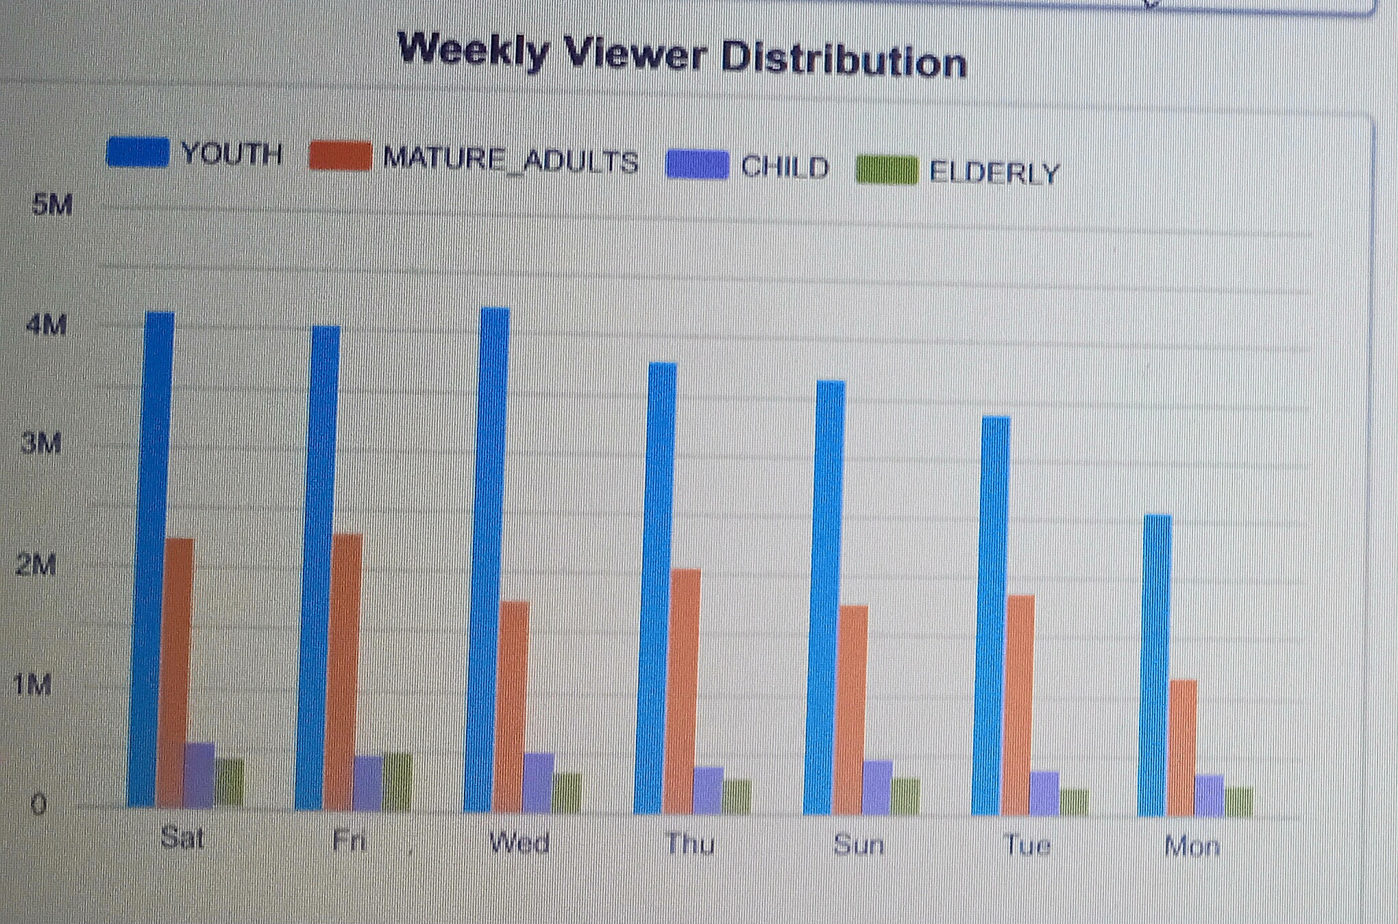
The above chart provides an overview of weekly TV vierwership across four audience.
Youth dominate throughout the entire week consistently reaching 3 to 4 million viewers
Children and Elderly audiences show significantly lower but stable.
With Saturday also maintaining strong numbers while Monday shows lowest.

Slide 12
Recommendations
Focus on high performing channels since they attract a lot of viewers and management should invest in advertising and promotions around these channels to maximize audience reach.
Deliver tailored content for youth and Mature Adults, our largest and most engaged groups.
Launch new shows and promotions on Friday and Saturday when engagement peaks
Replicate march`s subscription spike with regular monthly promotions and exclusive content drops.

